Slide 1
Arduino Workshop #9
The SPI Bus
Notes:
24 - Arduino Uno
24 - USB cables
24 - Red LED
24 - Yellow LED
24 - Green LED
24 - Blue LED
96 - 100 Ω resistors
24 - Speakers
24 - Jumper wire sets
24 - Breadboards
48 - MCP4231 Digital SPI potentiometer IC

Slide 2
The SPI Bus
Originally created by Motorola
Full-duplex communications standard
Enables simultaneous bidirectional communication
Between a master and one (or more) slave(s)
No formal protocol
Some devices operate slightly different
Number of bits
Slave select line
Other minor things

Slide 3
SPI can act in 4 main ways
SPI devices are synchronous (SCLK)
Data transmitted is in sync with the clock
Data is shifted into the device on the rising or falling clock edge of the clock signal (clock phase)
Default state can be set either high or low (called the clock polarity)
SPI Mode | Clock Polarity | Clock Phase
Mode 1 | Low Idle | Data Captured on rising edge
Mode 2 | Low Idle | Data Captured on falling edge
Mode 3 | High Idle | Data Captured on rising edge
Mode 4 | High Idle | Data Captured on falling edge

Slide 4
SPI hardware and communications design
The SPI system set up is relatively simple.
Three pins are used for communication
Shared/Serial Clock (SCLK)
Master Out Slave IN (MOSI)
Master In Slave Out (MISO)
Each device has an additional slave select (SS) pin
Total number of pins is 3 + n
n is the number of slave devices

Slide 5
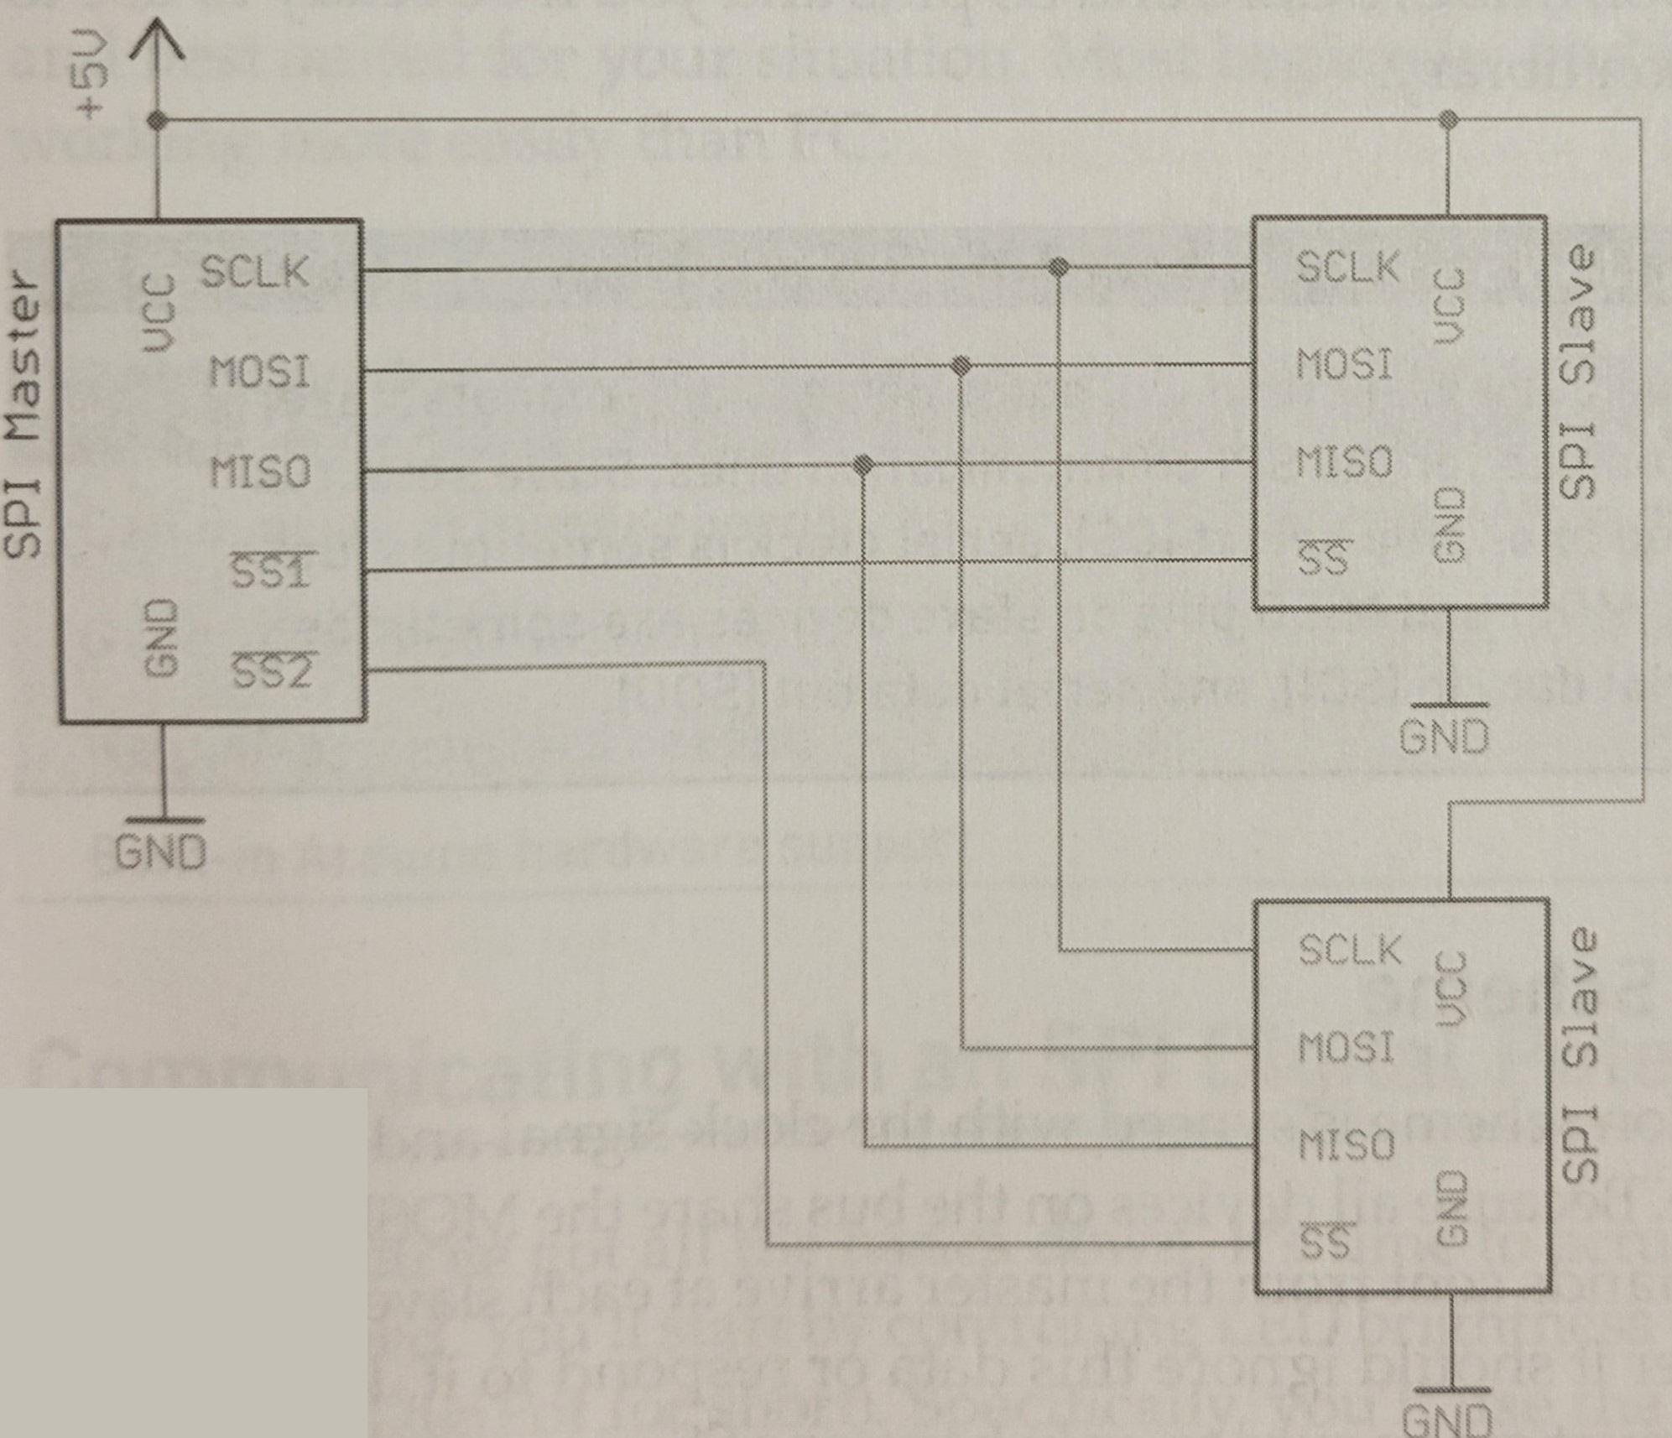
An example SPI system w/ 2 slave devices

Slide 6
What the I/O lines do and how they should be wired
SPI Communication line | description
MOSI | Used for sending serial data from the master to a slave device
MISO | Used for sending serial data from a slave device to the master device
SCLK | The signal by which the serial data is synchronized w/ the receiving device (so it know when to read the input)
SS | A line indicating slave selection. Pulling it low means you are speaking with that slave device

Slide 7
Notice
Unlike I²C bus
pull up resistors are not required
Communication is bidirectional
To wire an SPI device to the Arduino you simply need to connect the MOSI,MISO,SCLK, and SS pins
Because SPI is not a universal standard, manufacture may refer to lines differently
Slave select may be called chip select (CS)
Serial clock could be called just clock (CLK)
MISO and MOSI are sometimes abbreviated to serial data in (SDI) and serial data out (SDO)

Slide 8
Communication scheme
Basic process is as follows
Set Chip Select pin low (for the device you want to communicate with)
Toggle the clock line up and down at a speed less than or equal to the transmission speed supported by the device
For each clock cycle, send 1 bit on the MOSI line, and receive 1 bit on the MISO line
Continue until transmitting (or receiving) is done, and stop toggling the clock line
Return Chip Select pin to high state
Note:
Every clock cycle a bit must be sent and received, but that bit does not necessarily need to mean anything (we will use this fact later… it will be more clear then)

Slide 9
SPI vs I²C
SPI Advantages | I²C advantages
Can operate at higher speed | Requires only two communication lines
Generally easier to work with | Built in Arduino Hardware support
No pull up resistors needed
Built in Arduino support

Slide 10
Gathering Info from data sheet
Data sheet answers the following questions
What is the pin out of the IC and which pins are the control pins?
What is the resistance of the potentiometer in my chip?
Which SPI command must be sent to control the two digital wipers?

Slide 11
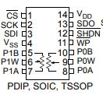
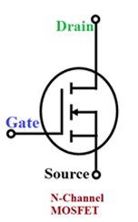
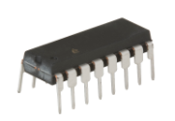
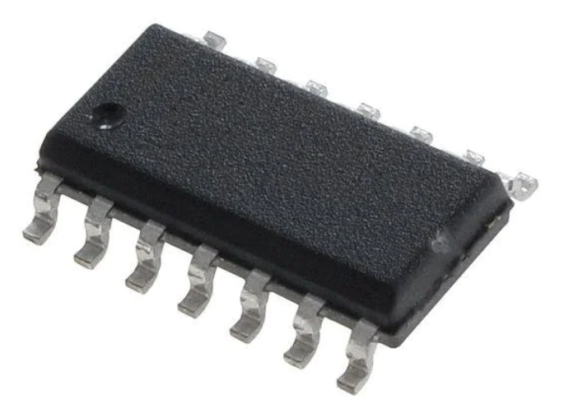
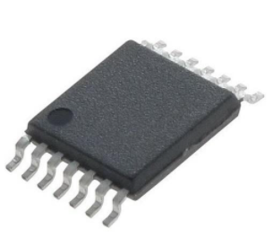
MCP4231 Pin-Out Diagram
P0A,P0W,P0B - 1st digitally controlled POT
P1A,P1W,P1B - 2nd digitally controlled POT
VDD - 5 V power
VSS - ground
CS - SS pi (bar above indicates its active low)
SDI, SDO - MOSI and MISO respectively
SCK - clock line
SHDN, WP - shutdown and wipe protect (WP is not connected, SHDN should be connected to 5 V)
Plastic Dual inline package
Small Outline IC
Thin Shrink Small Outline Package

Slide 12
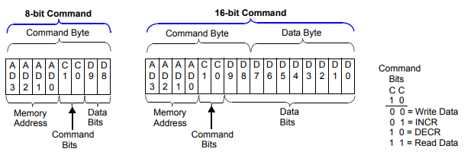
Understanding SPI commands you need to send
We see two command types
8 bit
Allows increment of potentiometer with single byte
16 bit
Allows to set state of POT arbitrarily
We will use 16 bit
It also indicates
POT 0 is address 0
To write to POT 0 you transmit 00000000
Followed by the value (0 to 128)
POT 1 is address 1
To write to POT 1 you transmit 00010000
Followed by the value (0 to 128)

Slide 13
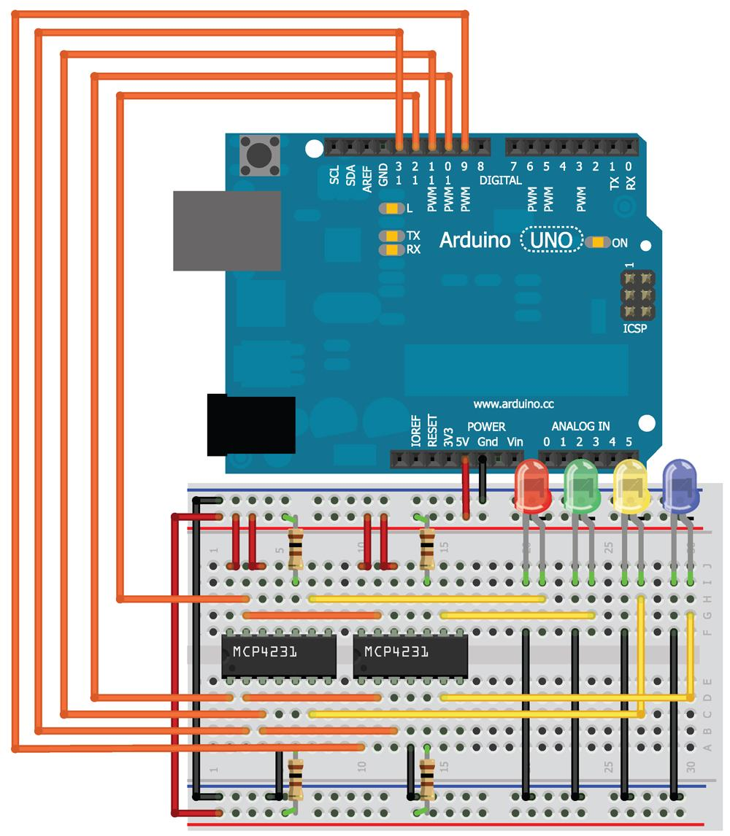
Let's wire up a project

Slide 14
How the project will work
When the wiper for the potentiometer is turned to max
Current flows from the 5 V rail through
The 100 Ω resistor
The wiper (~ 75 Ω)
Then the LED
The wiper for the POT is low
Current flows from the 5 V rail through
The 100 Ω resistor
The entire potential of the POT (10 ㏀)
The wiper (~ 75 Ω)
Then the LED
Even when the POT is low, the minimum resistance in series to the LED is 175 Ω (enough to safely current limit it)
As the digiPOT is changed the brightness will change
This method of control is useful if you have exhausted all your PWM pins

Slide 15
Writing the code
You want to import the SPI library first, then
Bring the CS pin for the chip low
Send the appropriate register/command byte to the choose the POT
Send the value between 0 and 128
Bring the CS pin for the chip High

Slide 16
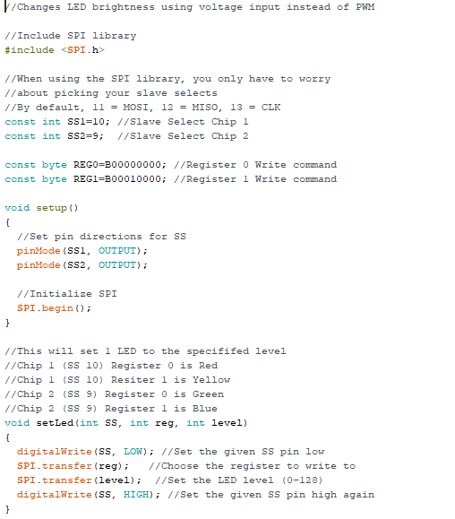
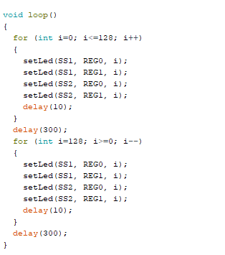
The Code
Part 2
Part 1
Download SPI_led from GitHub

Slide 17
New Commands and what they do
#include <SPI.h>
Allows you to include the SPI library from the Arduino libraries in your sketch
SPI.begin()
Enable you to initialize the SPI interface on the hardware SPI pins for the Arduino
SPI.transfer()
Sends data over the SPI BUS
Connection assignments
SS for chip 1 is connected to pin 10
SS for chip 2 is connected to pin 9
The byte registry is determined from the data sheet (as mentioned earlier)
“B” in front of a string of 1s and 0s creates a byte variable
Tells the Arduino it is a binary format
setLED()
Accepts and CS pin number , a register byte, and a POT setting
Transmits data to appropriate chip

Slide 18
Let’s do something a bit harder
We could control LED brightness with The PWM.
Something we can’t do with a PWM… make a tone
We will use the SPI digiPOT to control the volume of a speaker dynamically

Slide 19
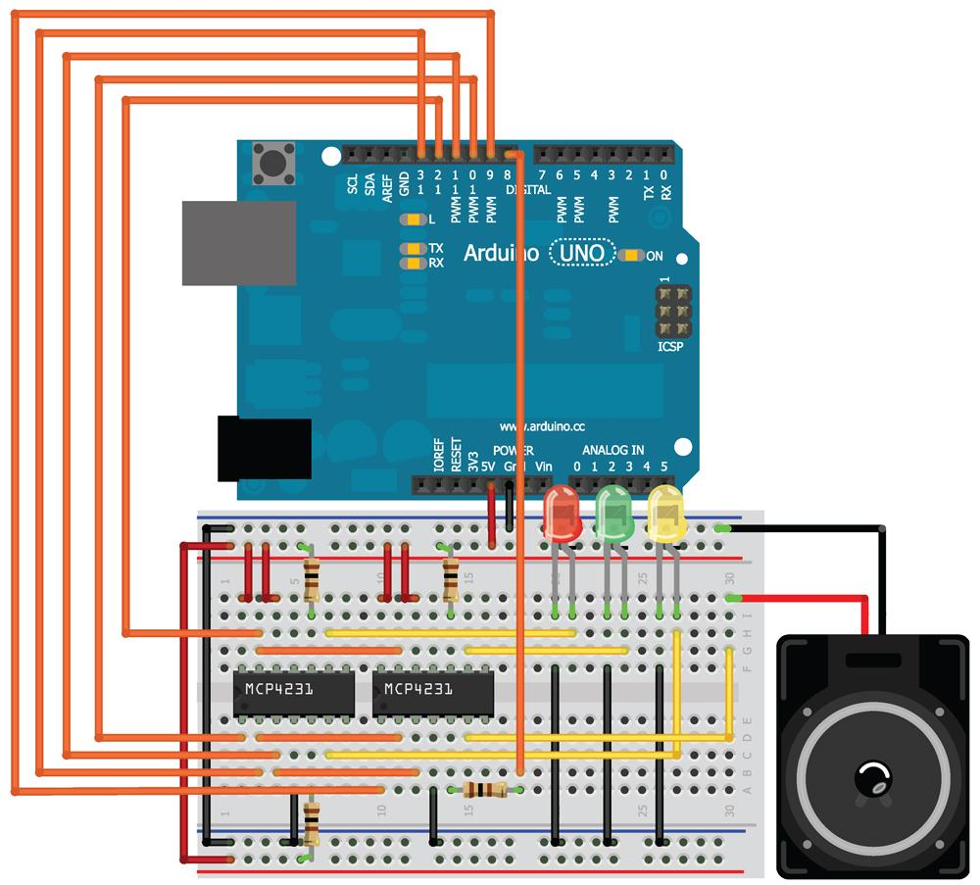
Wire it up

Slide 20
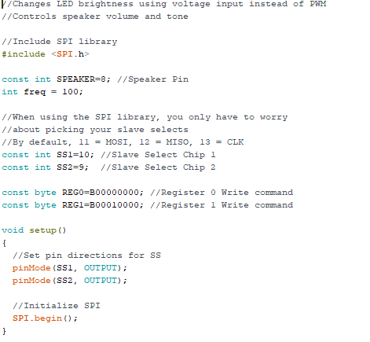
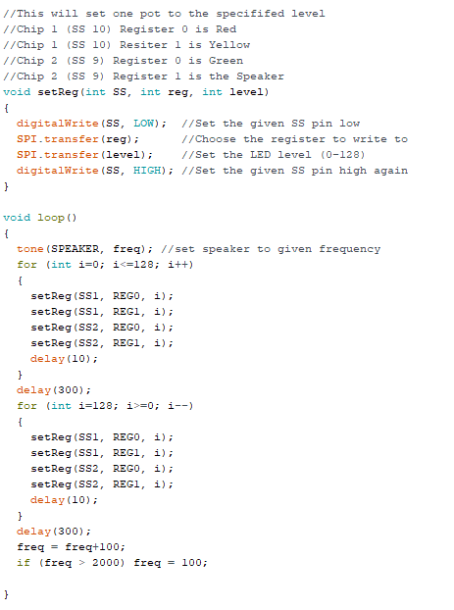
The code
Part 1
Part 2
Download LED_speaker.ino from GitHub

Slide 21
What should happen
Lights should change intensity
Speaker will change volume
On each cycle it will increase in frequency from 100 Hz to 2000 Hz

Slide 22
This is just a starting point
You could
Correlate the frequency and volume with sensor input
IR distance senor controls frequency based on movement
Correlate LED intensity with a different metric
Temperature
Sound
Light
Add a button to allow you to dynamically choose the volume or frequency of the speaker
Program the lights to match a simple musical sound

